Slide 1
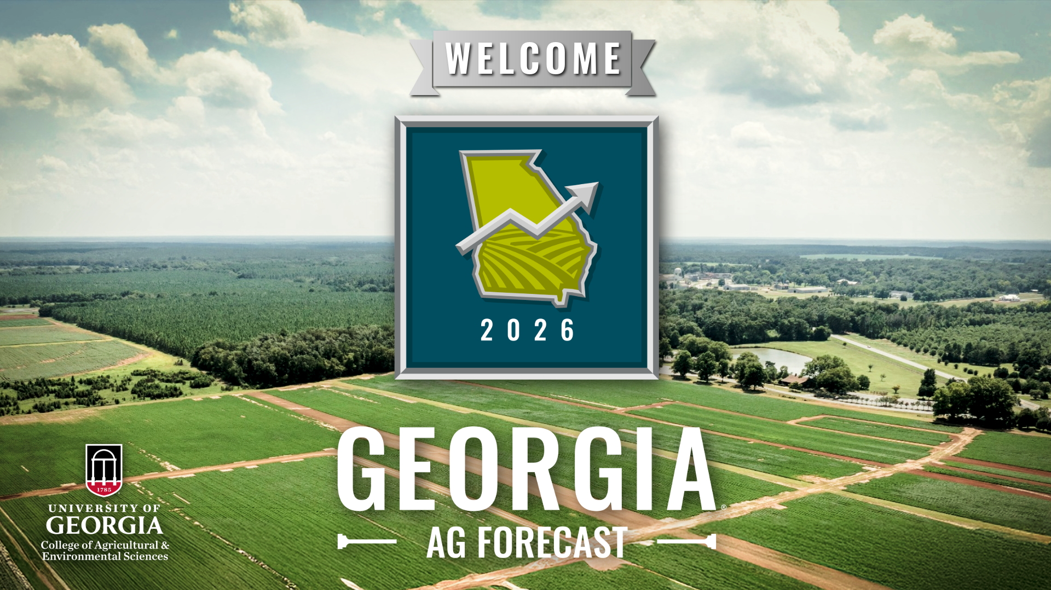
Welcome to the 2026 Georgia Ag Forecast event

Slide 2




Farm Credit Associations of Georgia Corteva Agriscience Georgia Agribusiness Council The Dairy Alliance

Slide 3
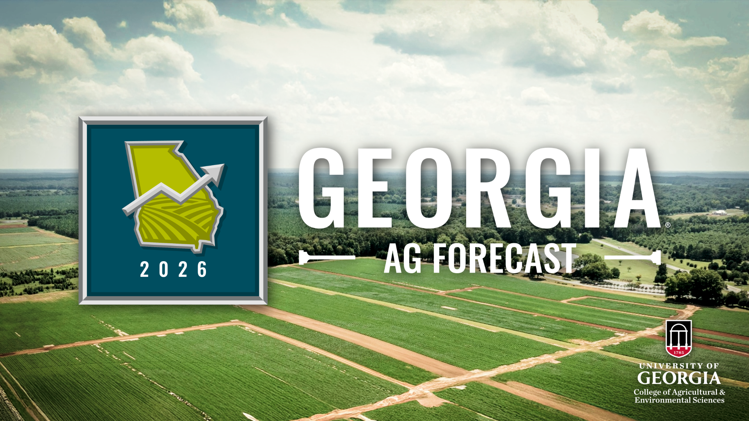
Georgia Ag Forecast first section

Slide 4
2026 Outlook for Georgia Agriculture
Ford Ramsey Gopi Munisamy
Department of Agricultural and Applied Economics

Slide 5
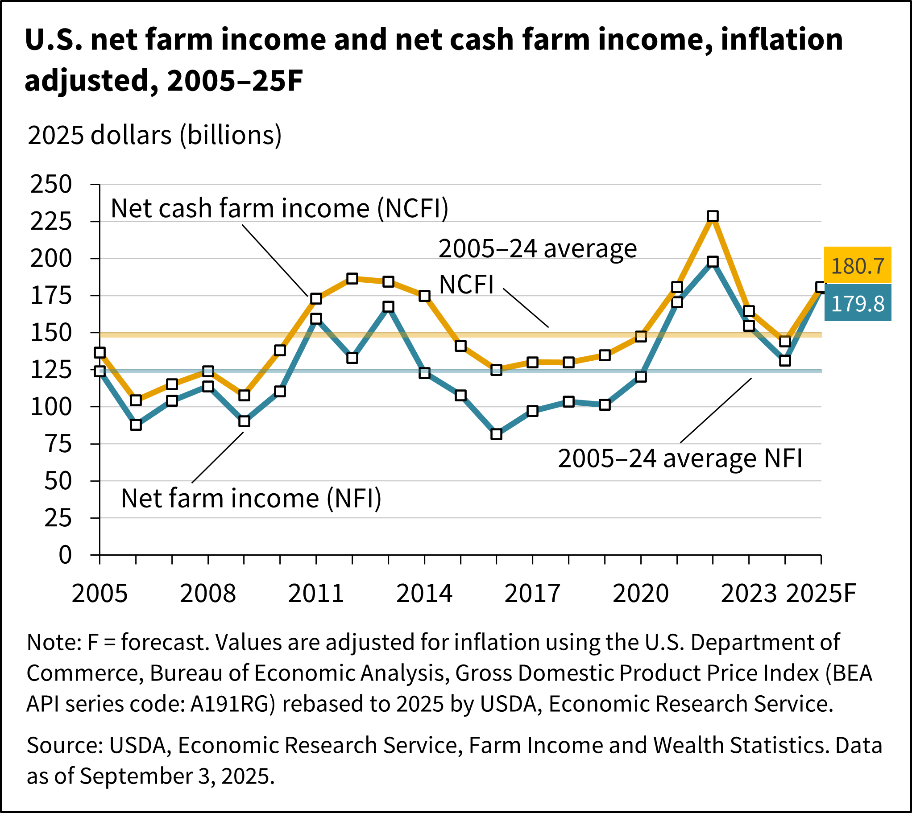
Pulse of the Ag. Economy Measured by Farm Income
Net Farm Income is income after expenses from production in the current year.
Net Cash Farm Income is income after expenses for cash transactions only.
Both net farm income and net cash farm income include government payments.

Slide 6
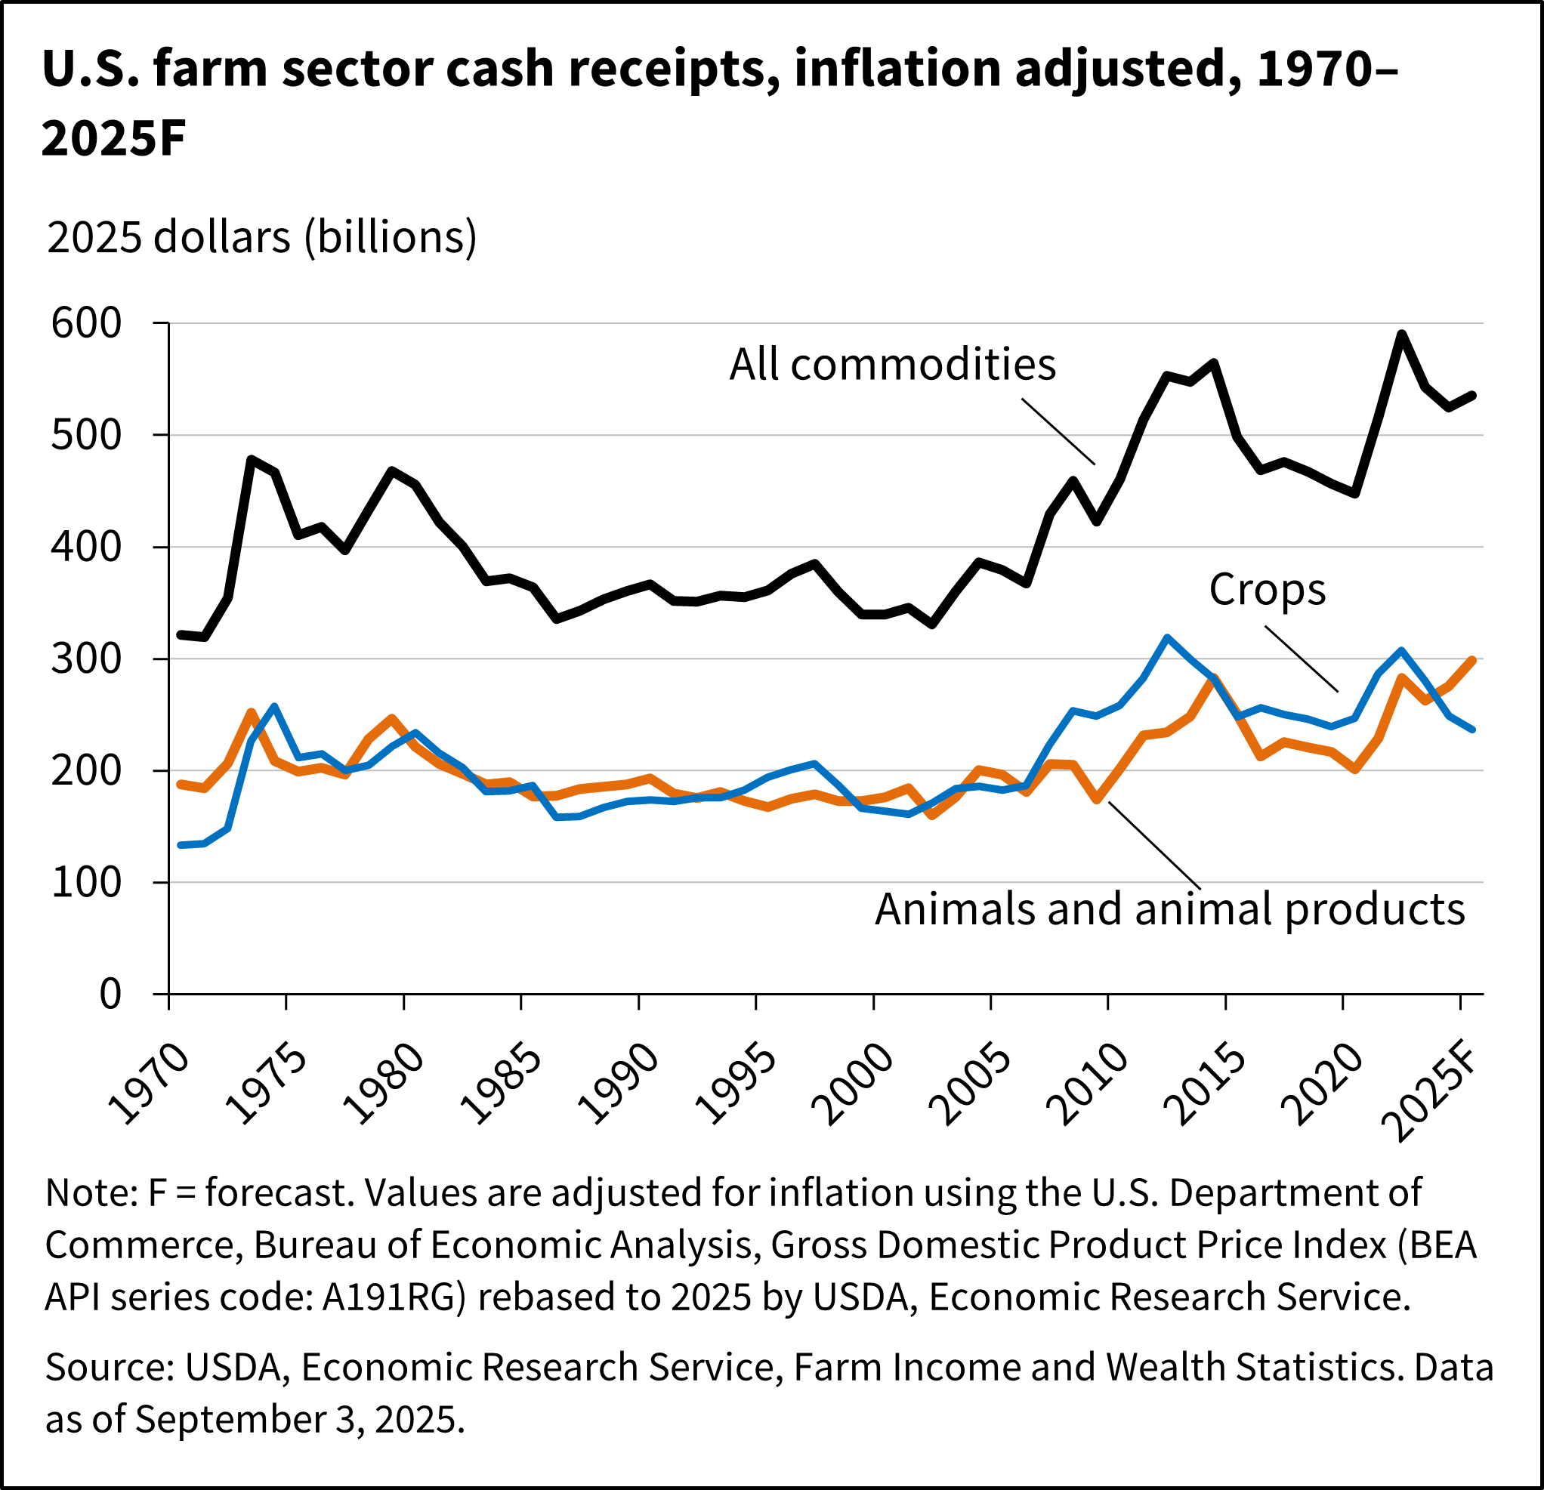
Crops and Livestock Move in Opposite Directions
Rising net farm income masks differences in receipts from crop and livestock production.
Receipts from livestock are up, largely on cattle and poultry.
Receipts from crops are down, largely on weak prices.

Slide 7
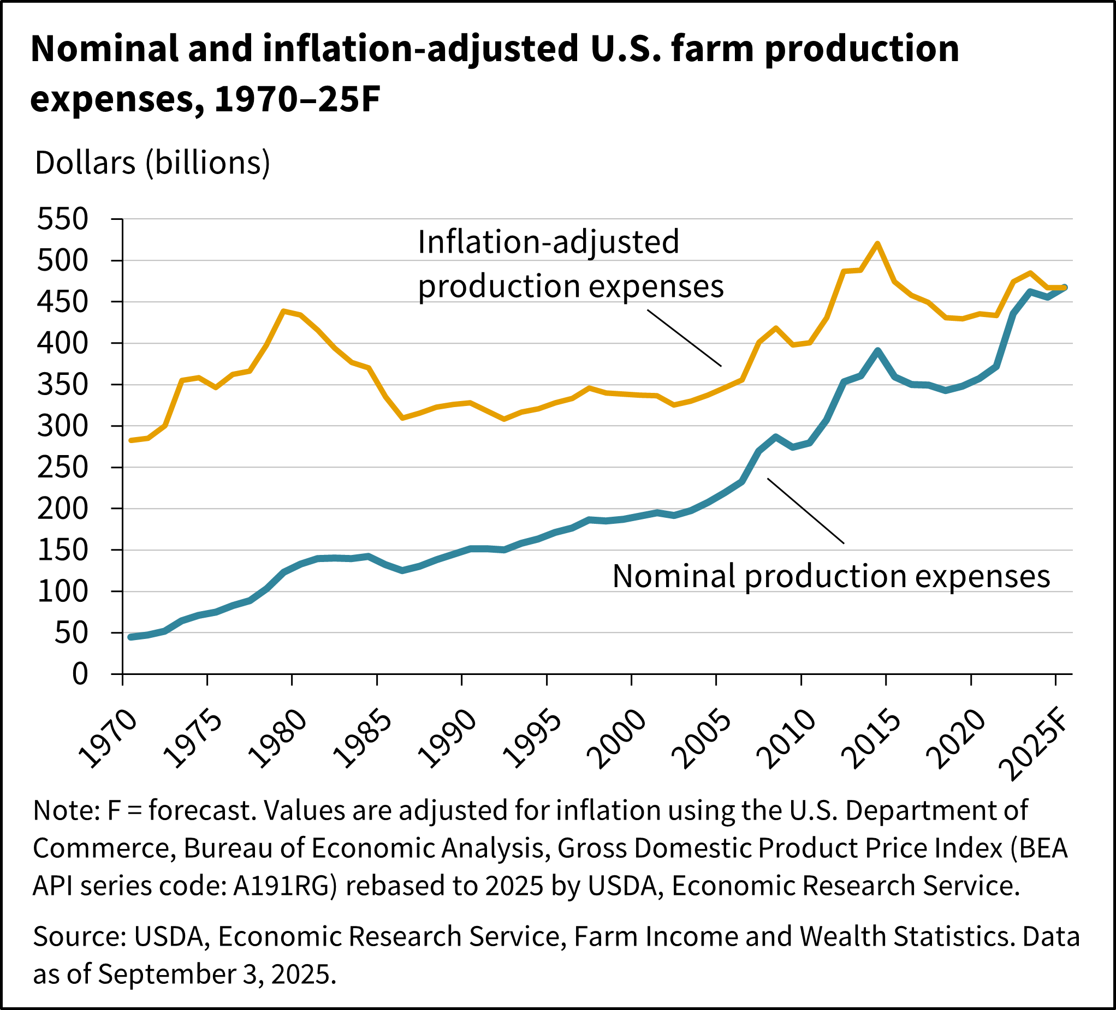
Production Expenses Are Flat After Increasing
Nominal expenses are up, at least partly due to inflation
Good news is that costs appear to have plateaued.

Slide 8
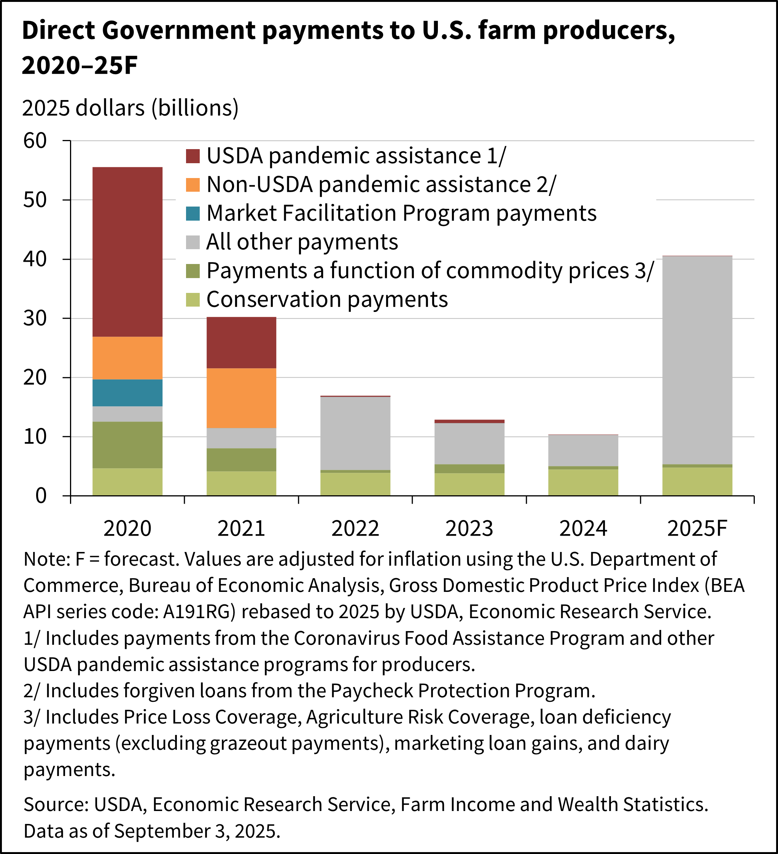
Government Payments Are Significant
Rising net farm income obscures the contributions of crop production and government payments.
Government payments will increase substantially in 2025.

Slide 9
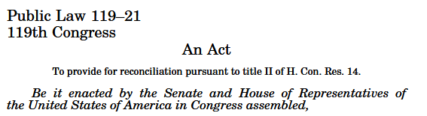
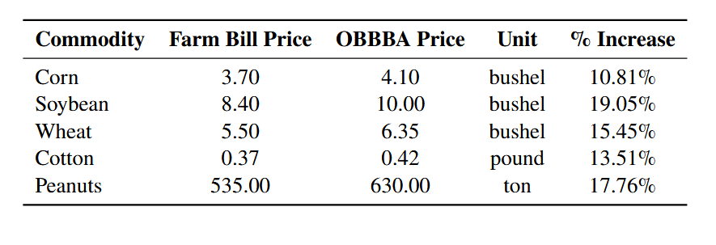
Changes in the OBBBA Support Ag.
Statutory reference prices for PLC
Base acre updates
Increased premium subsidies and insurance policy for poultry
Trade promotion

Slide 10
Crop Insurance Strengthened, Not a Cure-All
Indemnities from crop insurance are included in farm income.
Premium subsidies are not included.
Does not protect against multiple years of low prices.

Slide 11
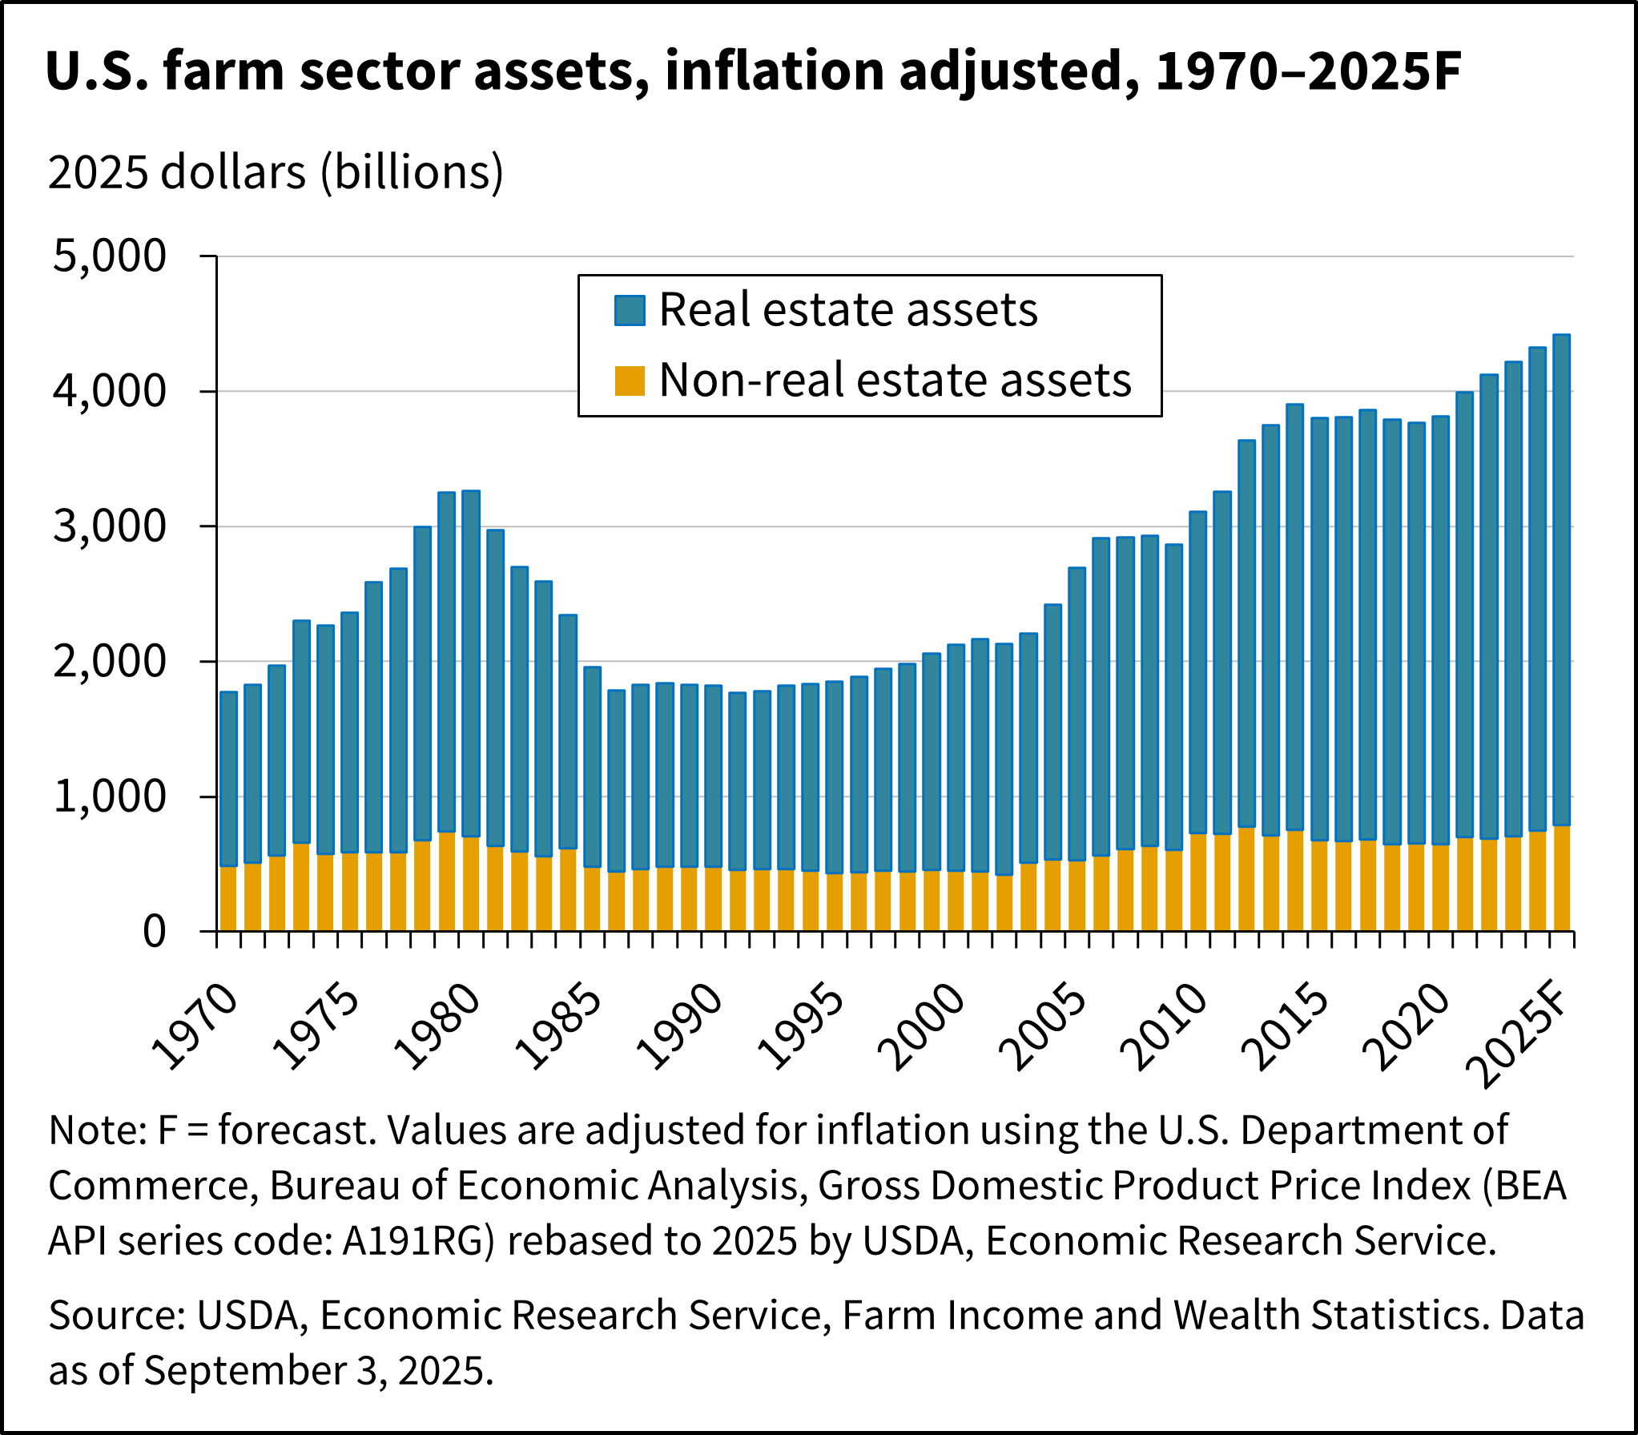
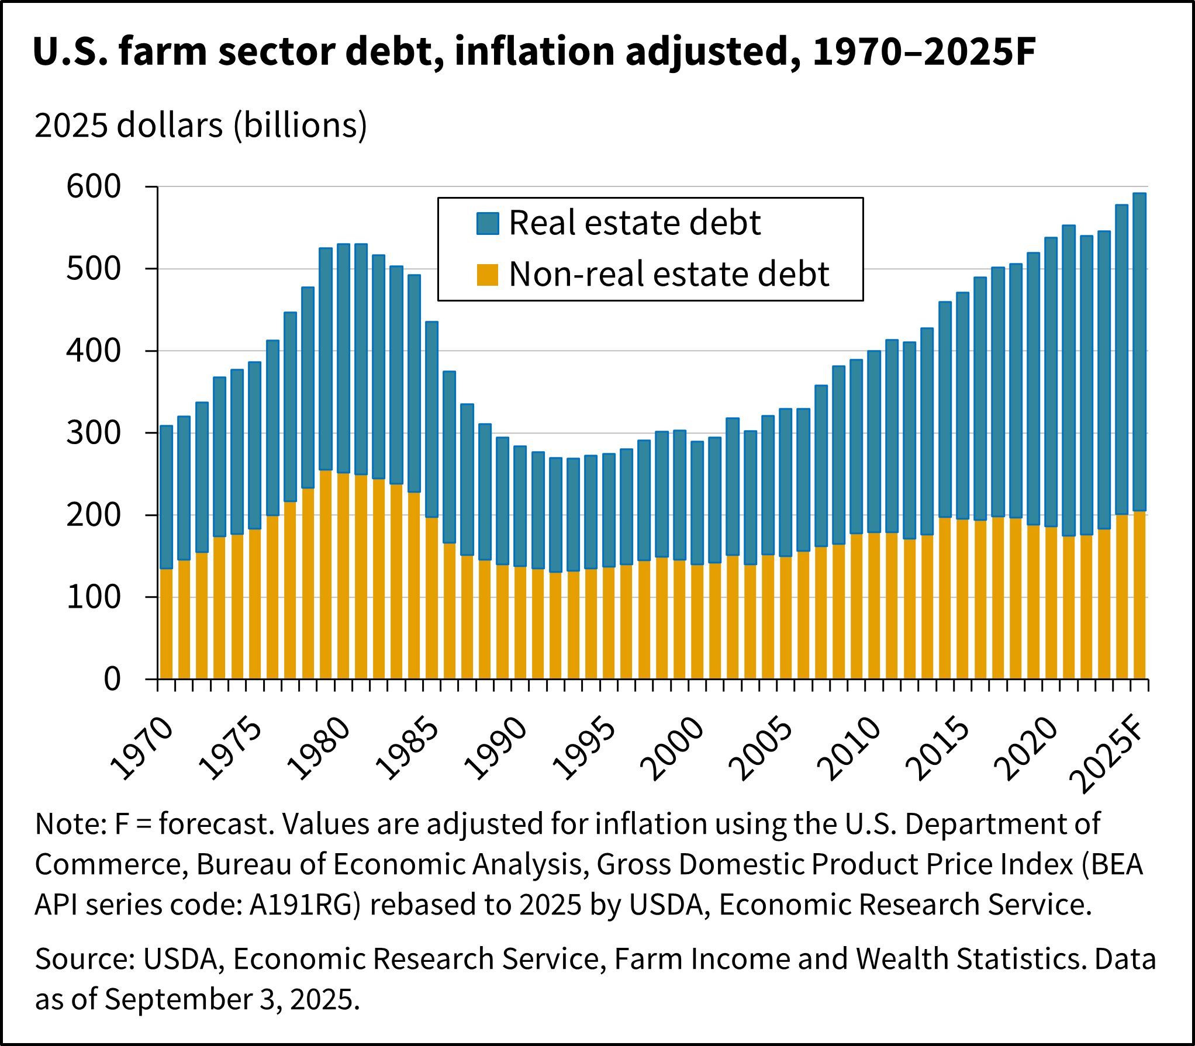
Wealth, Assets, and Debt Rising

Slide 12
Solvency and Liquidity Stable
Solvency refers to the ability of farmers to satisfy their debt obligations.
Liquidity refers to the ability to convert assets to cash quickly.
In 2025,
Solvency remained relatively stable
Liquidity likely improved
Chapter 12 bankruptcies in the Southeast increased from 40 in 2023 to 62 in 2024, but this is still a significant reduction compared to filings in 2020 and years prior.

Slide 13
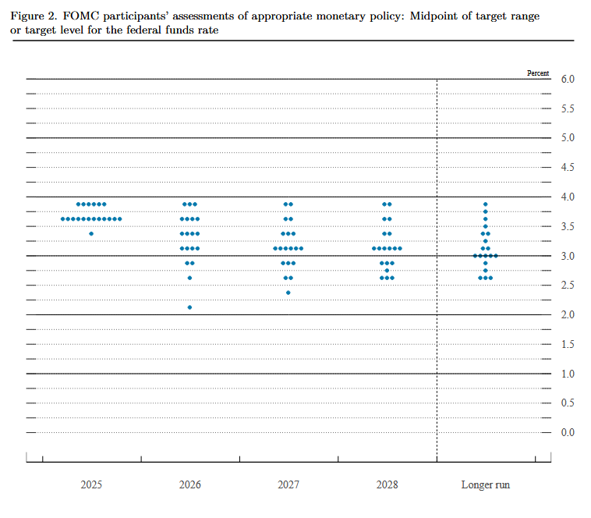
Monetary Policy May Result in Lower Borrowing Costs
The federal funds rate is about 3.6%.
Additional decreases in rates could provide some support to producers in the form of lower interest payments.
However, changes in the federal funds rate don’t always quickly pass through to the rates offered to borrowers.

Slide 14
Georgia Agriculture Remains Our #1 Sector
The 2025 Georgia Ag Impact Report estimates:
$17.6 billion in direct value of Georgia commodities,
$91.4 billion in economic contribution from food and fiber production,
and over 381,200 jobs.
The individual contribution of the top five commodities was
Broilers: $5.8 billion
Eggs: $988 million
Beef: $981 million
Cotton: $938 million
Peanuts: $915 million
Outlook is largely driven by the commodities above. Other important contributors are greenhouse/nursery, fruits and vegetables, dairy, tree nuts, and timber.

Slide 15
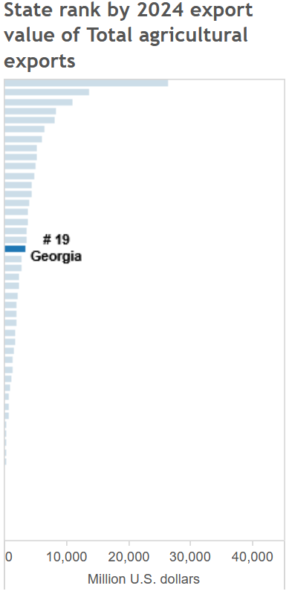
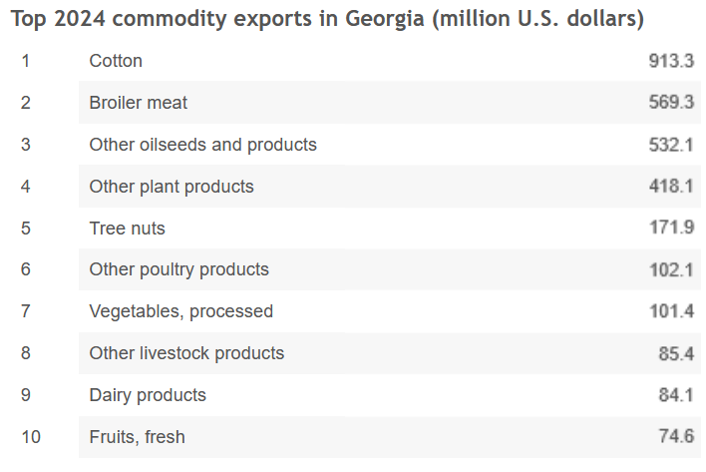
Title

Slide 16
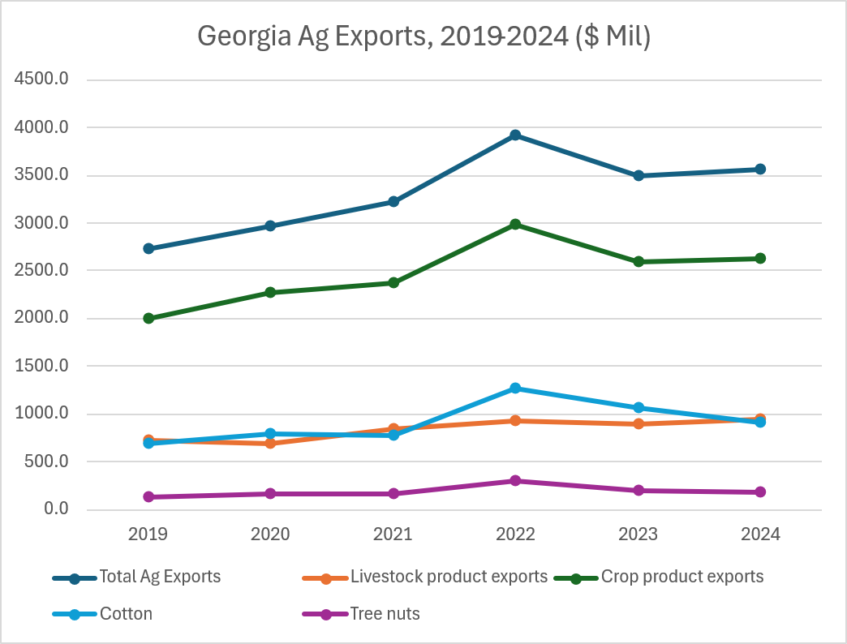
Record Ag. Exports in 2022, Slightly Up in 2024
Livestock product exports continue to grow
Declining export values for cotton and pecans
Trade considerations certain to affect 2025 and 2026 values

Slide 17
Georgia Farm Income Up in 2024 But…
Georgia net cash farm income was roughly $4.7 billion in 2024
This is well below the 10-year high of $5.4 billion in 2022
Government payments declined from 2020 onwards.

Slide 18
Increased Cash Income Due to Livestock Receipts
Gross cash income up in Georgia in 2024. Down for the U.S. overall.
Difference is due to livestock receipts and farm-related income.

Slide 19
Outlook for Georgia Ag. Economy
A few commodities account for nearly 75% of cash receipts
Big increase in US farm income forecast for 2025
Limited movement on the horizon for crop and livestock prices
Significant government payments in recent years
Farm income is naturally dependent on these commodities
Increased GA farm income in 2025. Forecast of net farm income ~$4.5 billion, net cash income ~$5.2 billion
Farm income remains stable in 2026
Stable farm income hides significant cost-price squeeze for crops

Slide 20

A Tale of Two Cities

Slide 21
Georgia Ag Forecast second section

Slide 22

















Faculty Working within Extension
Commodities
Production/
Consumer
Hospitality
General Agriculture
Department Head

Slide 23
Production Inputs and Expenditures
Total U.S. farm production expenditures remained mostly stable from 2024 to 2025, increasing less than 1% to $467.4 billion (USDA 2025)
Forecast U.S farm production expenditure sectors portray increases in livestock/poultry purchases, labor, and interest, and year-over-year reductions in pesticide and feed categories.
Farm operating loans will likely be around 7.5% (6.5-8.5%)
Nitrogen and phosphorus are expected to remain higher in 2026, while potash is mostly stable
2026 Georgia H-2A Adverse Effect Wage Rates decline to $14.47 per hour in 2026 from $16.08 in 2025
Guy Hancock
Notes:
Overall, total production costs were mostly stable from 2024 to 2025, rising by less than 1%, indicating cost changes largely offset for U.S. producers across farm sectors. Higher input costs were totaled for livestock/poultry purchases, hired labor, and interest expenses, while pesticide and feed expenditure categories declined.
In 2026, farm operating loan rates are expected to range from 6.5% to 8.5%, slightly lower than 2025 rates. Regarding fertilizers, nitrogen and phosphorus are forecast to be higher in 2026, as potash stays mostly stable
Finally, in 2026, one of the most notable fluctuations in input costs relates to the Adverse Effect Wage Rates in Georgia. The adverse effect wage rate declines to $14.47/hour in 2026, providing some labor cost relief compared to 2025 levels ($16.08/hour). This change will be especially impactful for producers of labor-intensive specialty crops in the coming year.

Slide 24
H-2A Adverse Effect Wage Rates (AEWR)
Georgia’s Adverse Effect Wage Rate (AEWR) is set to decline from $16.08 per hour in 2025 to $14.47 per hour in 2026, potentially easing labor cost pressures for H-2A employers.
Guy Hancock
Notes:
Georgia producers who utilize H-2A labor will see slight relief in the 2026 wage rates due to recent changes in the U.S. Department of Labor’s methodology for calculating the Adverse Effect Wage Rate (AEWR). After a 34% increase in H-2A wage rates from 2022 to 2025, the new AEWR for many Georgia operations is set to decline by about 10%, to an effective hourly rate of $14.47 in 2026

Slide 25
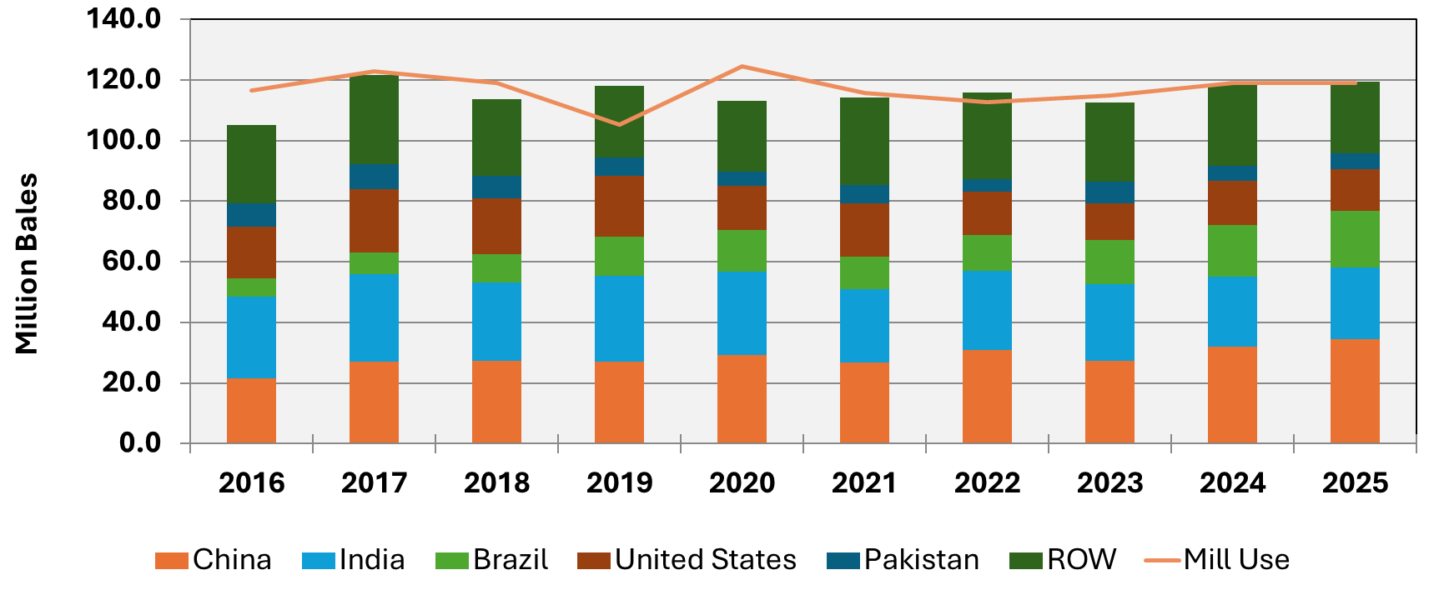

World Cotton Supply and Demand
Yangxuan Liu
Source: Data from USDA FAS
Notes:
Global economic growth has slowed compared with previous years, returning to more typical long-term rates. Global cotton demand has stabilized and remains relatively strong; however, competition in global cotton production and exports has intensified for U.S. cotton, driven primarily by expanded acreage in Brazil. Because production costs are lower in Brazil, Brazilian farmers are able to remain profitable, while U.S. producers are experiencing significant losses. Trade uncertainty has further weakened the position of U.S. cotton, as it has lost market access to China—traditionally one of its largest buyers—while Brazilian cotton has gained market share in China. As a result, U.S. cotton is currently in a transitional phase, seeking to stabilize existing markets outside of China and develop alternative export destinations. Without a significant improvement in demand for U.S. cotton, prices are likely to remain at their current low levels. Easing trade tensions with China, however, would represent a positive development for the U.S. cotton sector.

Slide 26
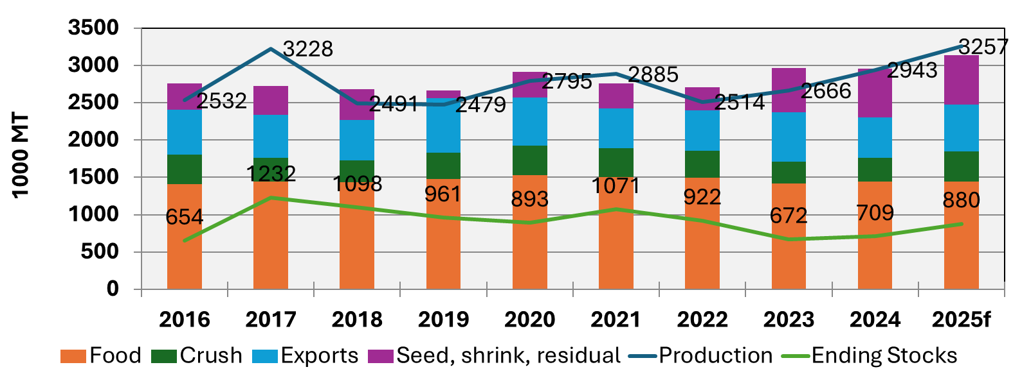
U.S. Peanut Supply and Demand
Yangxuan Liu
Source: Data from USDA FAS
Notes:
The year 2025 has presented peanut producers across the United States with a complex and evolving market environment. While acreage and production continued to expand, driven largely by growers shifting away from less profitable crops, the resulting surge in output has outpaced growth in both domestic use and export demand. As a result, U.S. peanut markets entered the 2025/26 marketing year with rising ending stocks and increasing supply-side pressure. At the same time, export growth has remained sluggish and domestic food use has expanded only moderately, creating a widening imbalance between production and demand. Together, these factors contributed to a sharp post-harvest price decline in late 2025 and have raised concerns about the persistence of downward price pressures as the market adjusts to abundant supplies and a slower-than-expected demand. With U.S. peanut supplies continuing to rise, developing alternative markets and new uses has become increasingly important. Expanding export opportunities remains essential, but innovative non-food applications, such as the use of peanut oil in sustainable aviation fuel, also offer promising ways to absorb surplus production and strengthen long-term market resilience.

Slide 27

U.S. Corn Supply & Demand
Source: Data from USDA, NASS
Amanda R. Smith

Slide 28
U.S. Soybean Supply and Demand
Source: Data from USDA, NASS
Amanda R. Smith
Source: Data from USDA FAS

Slide 29
Georgia Planted Acres of Corn, Soybeans, Wheat 2016-2025
Source: Data from USDA, NASS
Amanda R. Smith

Slide 30
Med & Lrg #1 & 2 Steer Calf Prices 500-600 Pounds, Georgia Weekly
Data Source: USDA-AMS, Compiled by LMIC
Livestock Marketing Information Center
Will Sector
Notes:
- Tight supplies will support prices at very high levels in 2026.
- Cattle inventories appear to be stabilizing this year, but major expansion appears to be further in the future.
- Consumer demand weakness from either softening ability or willingness to pay for high-priced beef is a significant risk to the outlook.

Slide 31
Milk Feed Price Ratio US Monthly Milk Price ($/CWT) to Commercial Prepared Feed ($/CWT)
Data Source: USDA-NASS
Livestock Marketing Information Center
Will Sector
Notes:
- The 2026 dairy outlook faces headwinds on increasing production that appears to be outpacing demand.
- Potential improvements on the supply and demand balance may occur later in the year.
- Opportunities from new local processing could support Georgia producers this year.

Slide 32
Weekly Average Chicken Production Federally Inspected, Ready-to-Cook Weight, By Month
Data Source: USDA-NASS
Livestock Marketing Information Center
Will Sector
Notes:
- The year ahead appears to be shaping up to be one of stable, incremental growth.
- After a strong start to 2025, significant production growth weighed on prices in the latter half.
- In 2026, supply and demand will likely find a better balance with indications of relatively stable prices.

Slide 33
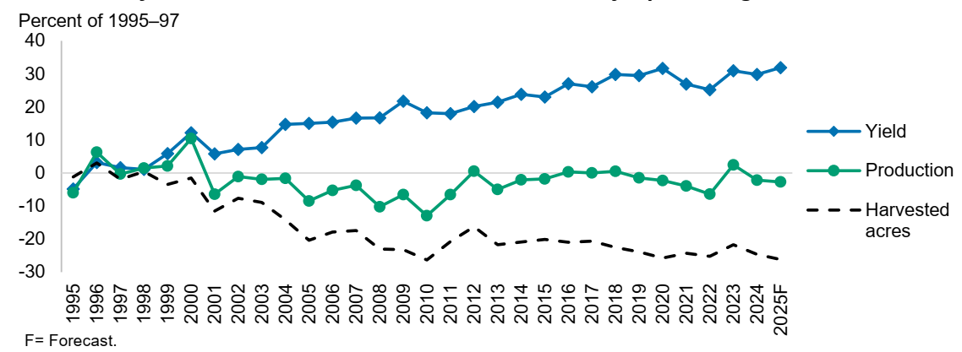

U.S. Vegetable Industry Overview, 1995-2025
Greg Fonsah
Notes:
The vegetable industry is very dynamic. In 2025, planted area was 912,000 acres whereas harvested was 905,900 acres. Due to continuous research, extension education and good agricultural practices and technology adoption, crop yields are consistently increasing for the past four decades. In 2025, the USDA reported yields of 461 cwt/acre for vegetables. Per capita availability in 2024 was 375.5 pounds, a 3.3% decrease compared to 2023. This is an indication that Americans are eating less vegetables.

Slide 34
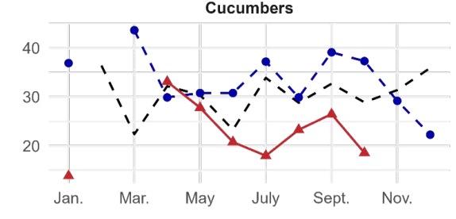
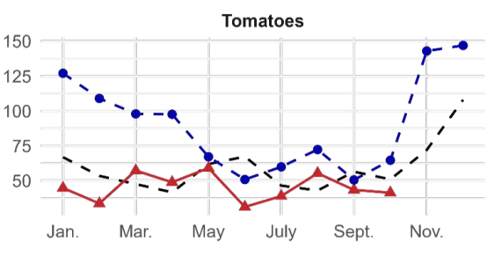

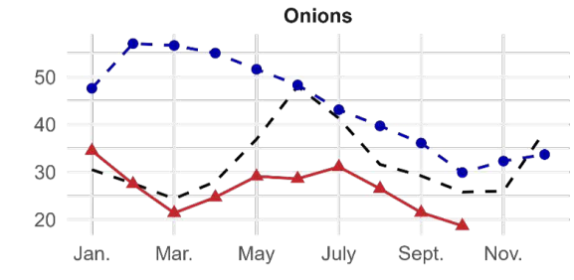
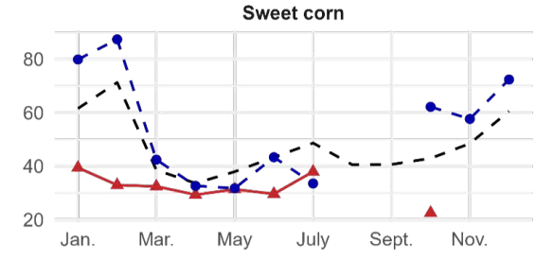
Vegetable Growers’ Suffered Depressing FOB Prices In 2025.
Greg Fonsah
Notes:
1. In 2025, fresh vegetable market experienced mixed signals. Growers’ prices decreased for key crops like onion, sweet corn, tomatoes, cucumbers, cauliflower, broccoli, lettuce etc. most of which are in the top ten vegetable crops in Georgia. Specialty crops farmers experienced weather challenges as it was wet in the West and dry in the southeast. The good news is that the Trump Administration provided $12 billion Farmer Bridge Assistance (PBA) to support growers impacted by unfair market disruption. Out of which $11 billion was allocated to row crop farmers and only $1 billion allocated to the specialty crop farmers. According to USDA, a broader efforts will continue to strengthen farm markets and the US agricultural safety net.

Slide 35
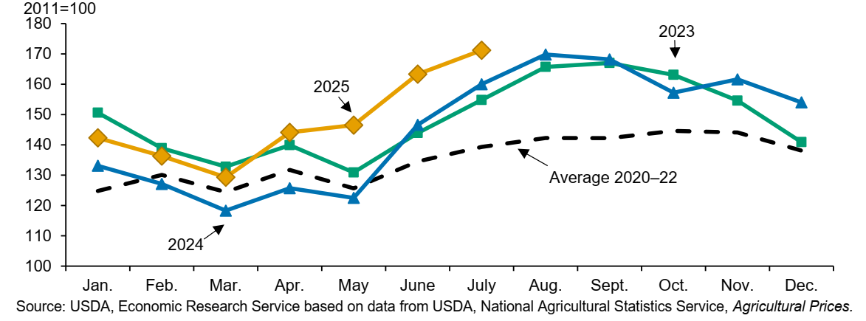
Improved Fruits & Tree Nuts Grower’s Price Index (GPI), 2020-2025
Greg Fonsah
Notes:
Despite the challenges faced by the fruits and tree nuts industry, the specialty crop growers are resilient and the industry is still sustainable. For instance, the Fruits & Tree Nuts growers received better prices in 2025 crop season compared to the previous 2024 crop season. In July 2025, fruits & tree nuts growers’ price index (GPI) was 171 (2011=100). In the first quarter, the grower price index was downward trending but still higher than 2024 and started escalating until July where the GPI was 7% higher than July 2024 and 11% higher than July 2023. Although it is difficult to predict the prices in 2026, we believe the industry will continue to be strong.

Slide 36
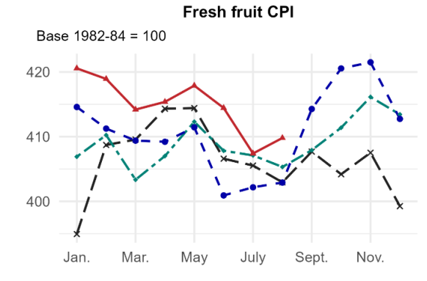
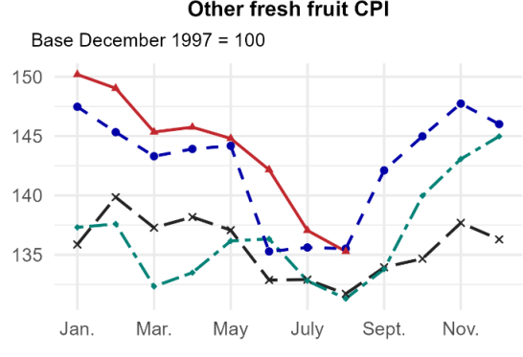
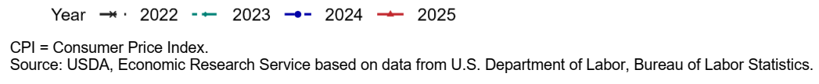
Consumer Price Index (CPI) for Fresh and other fruits 2022-2025
Greg Fonsah
Notes:
In August 2025, CPI for fresh fruits was 409.8 (1982-84=100). This was 2% increase from same time in 2024. This increase was caused by the high prices for apple and banana that increased by 14% and 19% respectively. The combined increase was 3 times higher than the 11% increase for Citrus CPI. In August 2025, CPI for apple, banana and citrus were higher compared to August 2024 whereas the other fruits CPI was unchanged. On the other hand, In August 2025, the apple, banana and citrus CPIs were higher than in 2024, Whereas other fresh fruit CPI did not change a year ago. Although GA peach industry was badly hit by freeze-damaged in 2023, production increased to 37,000 tons in 2024 and experienced another decline 2025 crop season by producing 30,000 tons according to USDA report. Although more than 90% of blueberry shipment took place between April and August, GA and FL shipments were low. On the other hand, GA pecan was impacted by bad weather.

Slide 37
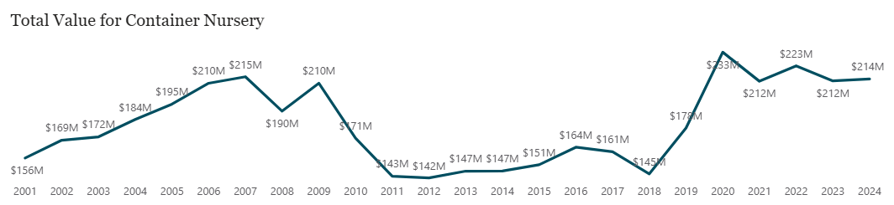
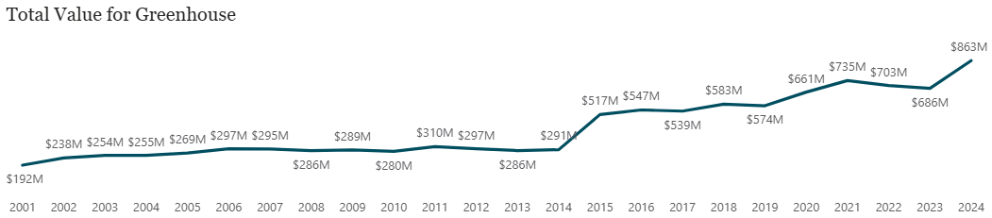
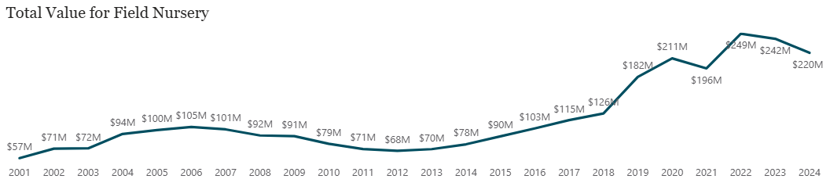
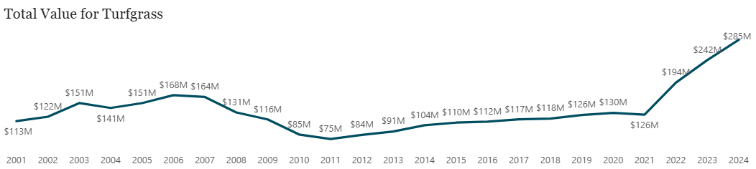

Green Industry
Container: stagnate growth over last couple of years
Field: large growth but leveling off
Greenhouse: modest growth
Turfgrass: large growth
2026 Forecast:
Depends on the economy
Slower housing market
Predicted good weather (warmer winter, warm summer)
Expect stagnate growth
Ben Campbell
Notes:
Since 2020 all sectors of the green industry have seen positive growth. Container nursery has stagnated since coming off 2020 highs. Field nursery has seen some decline over the last couple of years. Greenhouse and turfgrass have continued to trend upward, notably on strong housing demand. However, economic uncertainty, notably a slowing housing market is cause for concern. Continued growth in the housing sector will fuel increased green industry growth. Though increasing perceptions of a recession occurring will temper growth throughout 2026.

Slide 38
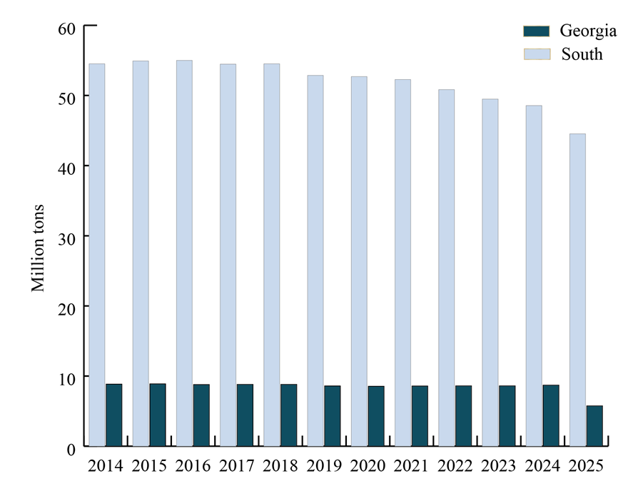
Timber
Pine sawtimber prices are expected to stabilize, but remain under pressure
High tariffs on Canadian softwood lumber imports help support demand for U.S. lumber and timber
Pine sawtimber prices expected to firm in Hurricane Helen-affected areas
Pulpwood prices in South Georgia continue to decline
Wood-using pulping capacity in the U.S. South and Georgia, 2014-2025
Yanshu Li
Chart Source: Forisk (2025).
Notes:
Pine sawtimber prices are expected to stabilize but remain under pressure as housing starts continue to face headwinds (high construction costs, labor shortage, and tight housing affordability)
High tariffs on Canadian softwood lumber imports help support demand for U.S. lumber and timber
Pine sawtimber prices are expected to firm in Hurricane Helen-affected areas of South Georgia due to local inventory shortages
Pulpwood prices in South Georgia continue to decline as the impacts of the recent mill closures show and salvage activities continue (Several state disaster relief incentive programs become available or get extended)

Slide 39

Looking ahead, the forecast for hospitality and travel in 2026 remains optimistic for rural stakeholders, despite broader economic pressures.
Rural Rebound: In 2024, rural lodging demand experienced a rebound with 1.1% growth, reversing a decline from the previous year.
Event-Driven Growth: Modest growth is expected overall in 2026, boosted by major events like the FIFA World Cup, but "rural stays" specifically are predicted to remain strong alongside this international influx.
Nature Preference: This trend underscores a continued traveler preference for the less-crowded, nature-based destinations that characterize Georgia's agritourism and rural offerings.
John Salazar

Slide 40

Georgia's Agritourism Outlook
Operators are optimistic for the next five years (Nal Survey, n = 1,400+):
75% expecting increased visitation and profitability.
However, access to financial capital, regulatory uncertainty, and inadequate infrastructure are the primary barriers limiting growth.
Georgia visitors are planning to revisit agritourism farms and willing to pay premiums for locally produced food.
Visitors prioritize facility cleanliness, safety, restrooms, and knowledgeable and friendly staff when deciding to participate in agritourism activities. (Nal survey 2024, n = 1,872)
Angie Im
Vanessa Shonkwiler
Notes:
Authors: Extension Specialists Angie Im & Vanessa Shonkwiler
Speaker notes:
Agritourism represents a growing opportunity for Georgia's agricultural sector, combining farm operations with tourism experiences to diversify income streams and strengthen rural economies.
A recent National Agritourism Producer Survey provides the snapshot of how producers view the opportunities, challenges, and future direction of agritourism. The most common agritourism activities provided include on-farm direct sales (62.8%), educational activities (59.4%), events and off-farm direct sales (35.9%, and 35.6% respectively), followed by U-pick (31.9%).
Farmers engaged in agritourism face a range of challenges that limit the growth and sustainability of their operations. The most pressing issues relate to limited access to financial capital, uncertainty, and complexity in regulatory compliance, and inadequate physical infrastructure and destination amenities.
Despite the challenges, the national survey emphasizes that agritourism producers felt optimistic about the future of the segment. Overall, 75.1% of operators felt the number of visitors to their operation would increase moderately or significantly over the next five years, 72.3% felt that way about their operation's profitability, and 68.4% expected to diversify in terms of agritourism activities offered to visitors.
In 2024, a national consumer survey was conducted by the Hospitality and Food Industry Management program at the University of Georgia to understand visitors’ perspectives toward agritourism. Out of a total number of 1,872 completed responses, 1,664 participants reported that they had participated in agritourism activities in the past two years.
consumers underline facility cleanliness as one of the crucial attributes, followed by safety and on-site restrooms. In addition, employee friendliness and knowledge were also recognized as one of the most significant attributes. Figure 1 presents the results of the top ten important attributes.
The 2026 FIFA World Cup in Atlanta presents a strategic opportunity to showcase Georgia's agricultural heritage to national and global audiences by collaborating with destination marketing organizations, universities, Extension services, and local communities to create memorable visitor experience will provide significant growth opportunities for Georgia agritourism sector.

Slide 41
Direct-to-Consumer Sales in Georgia 2025 Insights and 2026 Outlook
Many recommendations for growers available in the article!
Marketing messages should emphasize freshness, sustainability, local economic impact, and community connection to leverage positive perceptions of farmers’ market.
Younger buyers respond strongly to environmental and ethical messaging, while older buyers remain focused on more functional attributes such as freshness and reliability.
Tailored communication and engagement strategies can help move more consumers from “occasional” to “regular” market visitors.
Major trends in 2026:
Hyper-local and regenerative sourcing, Smart labelling or multi-labelling, Functional benefits of fresh produce, Digital engagement with personalized marketing and AI, Engaging younger generations, and Waste-reduction education.
Angie Im
Vanessa Shonkwiler
Notes:
Authors: Extension Specialists: Vanessa Shonkwiler & Angie Im
Speaker notes:
DTC marketing strategies should reflect the diverse needs and preferences of different generations of buyers.
Younger generations of promoters tend to value a broad range of attributes, an ‘all-of-the-above’ approach, whereas older generations place the greatest emphasis on freshness.
The challenge, and opportunity, lies in enhancing their educational and entertainment dimensions to attract broader audiences, especially younger generations and new shoppers.
For Georgia producers, this means leveraging these positive perceptions through marketing messages that emphasize sustainability, local economic impact, and community connection, while designing more engaging market experiences that would strengthen consumer engagement.
Georgia’s farmers market shoppers can be grouped into two distinct profiles: the core committed local food supporters who value sustainability and community, and emerging or occasional buyers who need more convenience, awareness, and price justification.
Major Trends in 2026
Hyper-local and regenerative sourcing
Consumers are increasingly conscious about where their food comes from and how it was grown.
Smart labelling or multi-labelling
Consumers want more transparency: origin, how it was grown (certified organic, regenerative, etc.), nutritional facts, and carbon footprint.
Functional benefits of fresh produce
Fresh, locally grown produce is increasingly positioned not just as “fresher” but as “health-enhancing”, i.e., rich in nutrients, minimally processed, supportive of wellness.
Digital engagement with personalized marketing and AI
The shift to personalized marketing using digital tools and AI, enables farms and markets to craft more relevant messages
Engaging younger generations
Young consumers, Generation Z (born 1996-2012), and soon Gen Alpha (born after 2012) value visually rich storytelling, shorter attention spans, and influencers.
Waste-reduction education
Consumers increasingly care about food waste, shelf-life, spoilage, and extending the life of fresh produce.
NOTE that recommendations are available in the article:
Recommendations on how to adapt to the major trends
Recommendations for Georgia producers already selling DTC
Recommendations for Georgia producers thinking about entering DTC

Slide 42

Check out our digital Georgia Ag Impact Report to find detailed insights on commodities across the state.

Slide 43
Georgia Ag Forecast ending slide

